Slide 1
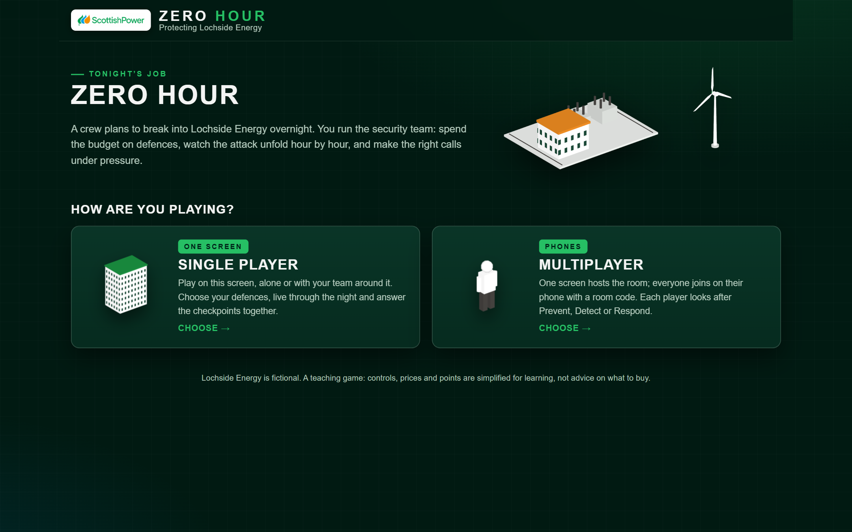
STRATHHACK26 · TEAM 20
Zero Hour
A digital cyber defence game for ScottishPower teams. Spend £3 million, survive a night-long ransomware attack, and make the right calls yourself, alone or team against team.
Play it now: team-20-vglm.onrender.com
Tejas · Rayyan · Ghassan · Vansh · Mo
Notes:
Hi, we are Team 20. Zero Hour turns ScottishPower's tabletop cyber game into a browser game. Our business is Lochside Energy: you have £3 million to spend on defences before a ransomware attack plays out overnight. It is live right now at the address on screen, and you can play it alone or as teams competing in one room.

Slide 2
A proven game that only works in a room
THE PROBLEM
Today
What we built
Two ways to play
Paper cards and a facilitator in the room
Behaviour questions are a separate quiz
Only reaches people at onboarding events
A browser game: no install, no account
The 40 questions built into every phase
Live on the web, ready for any team
Single player: one screen, one team around it
Team battle: phones join a room, up to 15 teams compete
Same night, same attacks: best wall wins
Foundation + behaviour questions in the scoring · Stretch = Multiplayer, extended into a team battle
Notes:
The tabletop game works, but only with a facilitator in a room, and the behaviour quiz sits on its own. We built a browser game with the questions inside every phase. It has two modes: single player for one screen, and a team battle where up to 15 teams join from their phones and compete against the same attack. That is the Foundation plus the Multiplayer stretch.

Slide 3
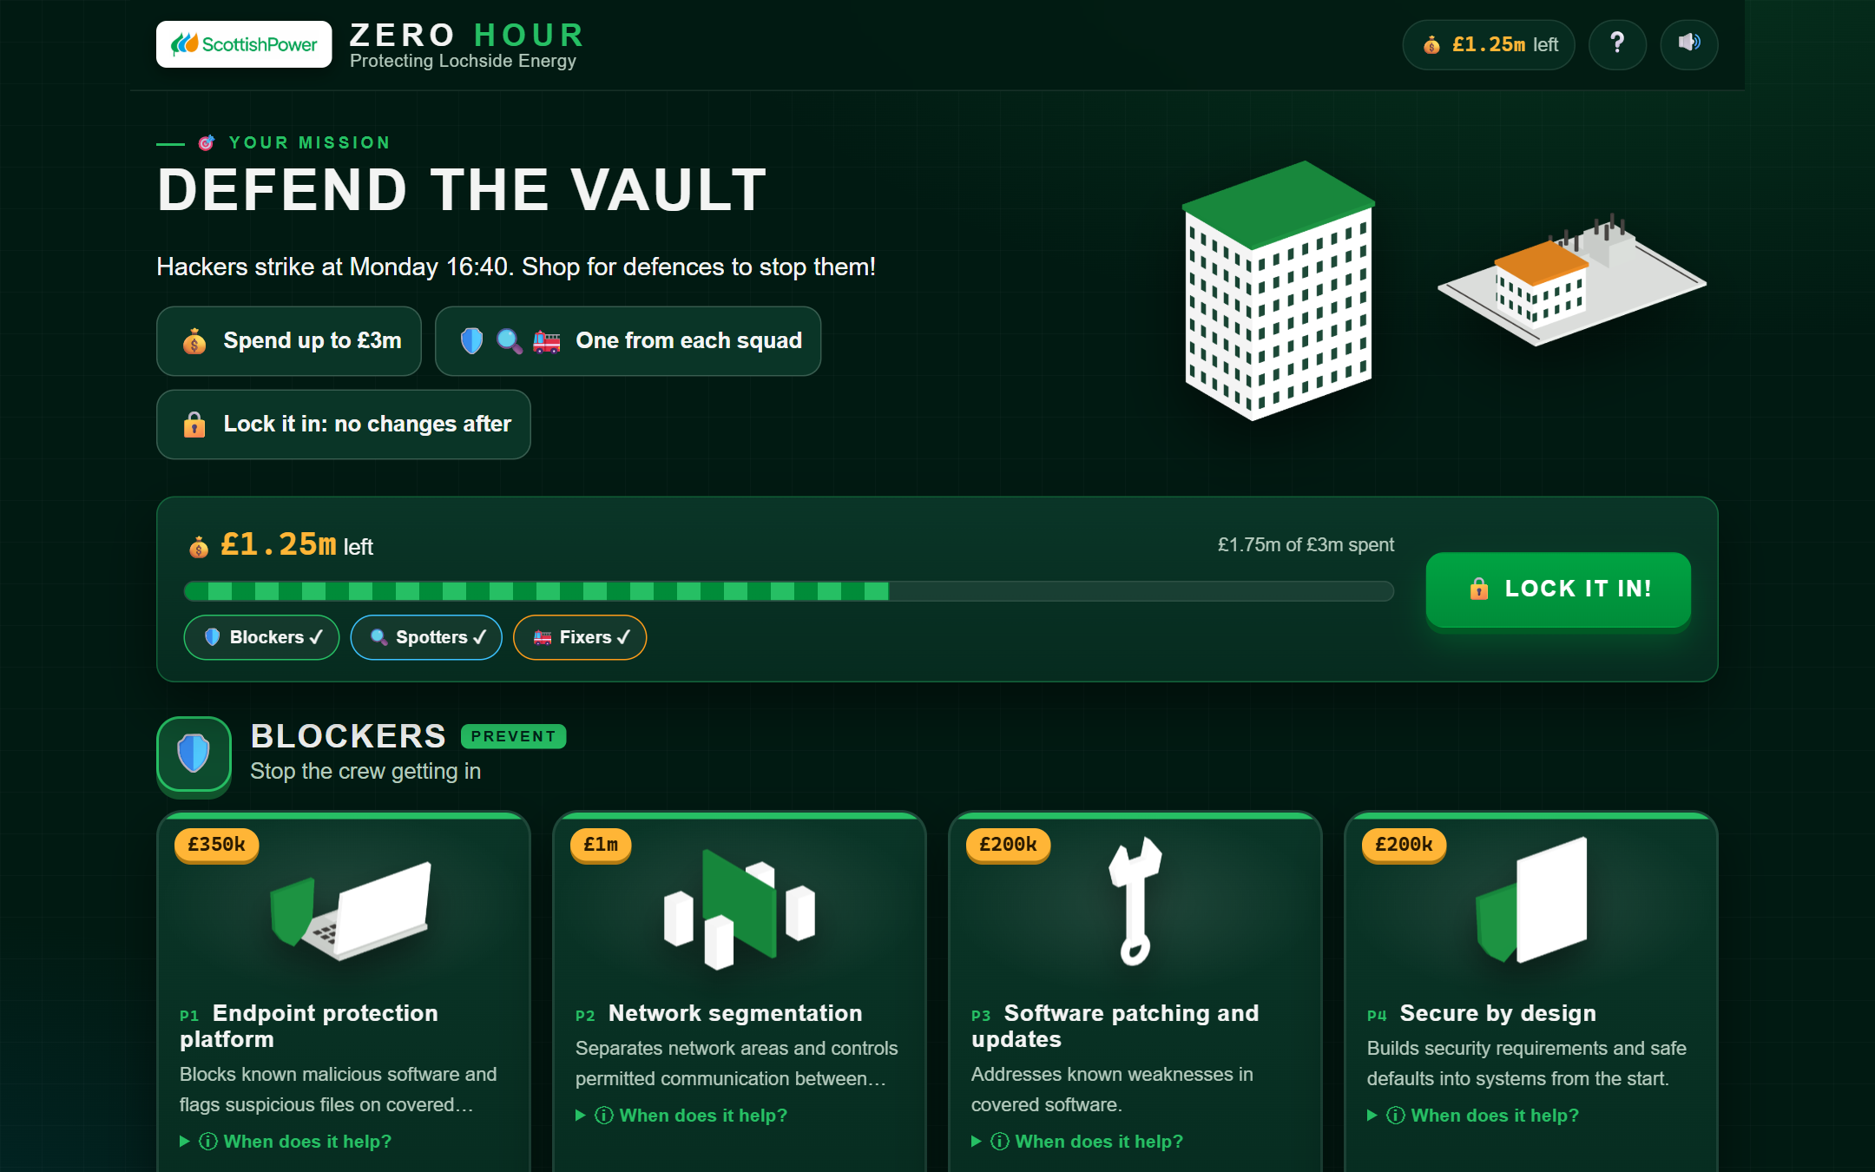
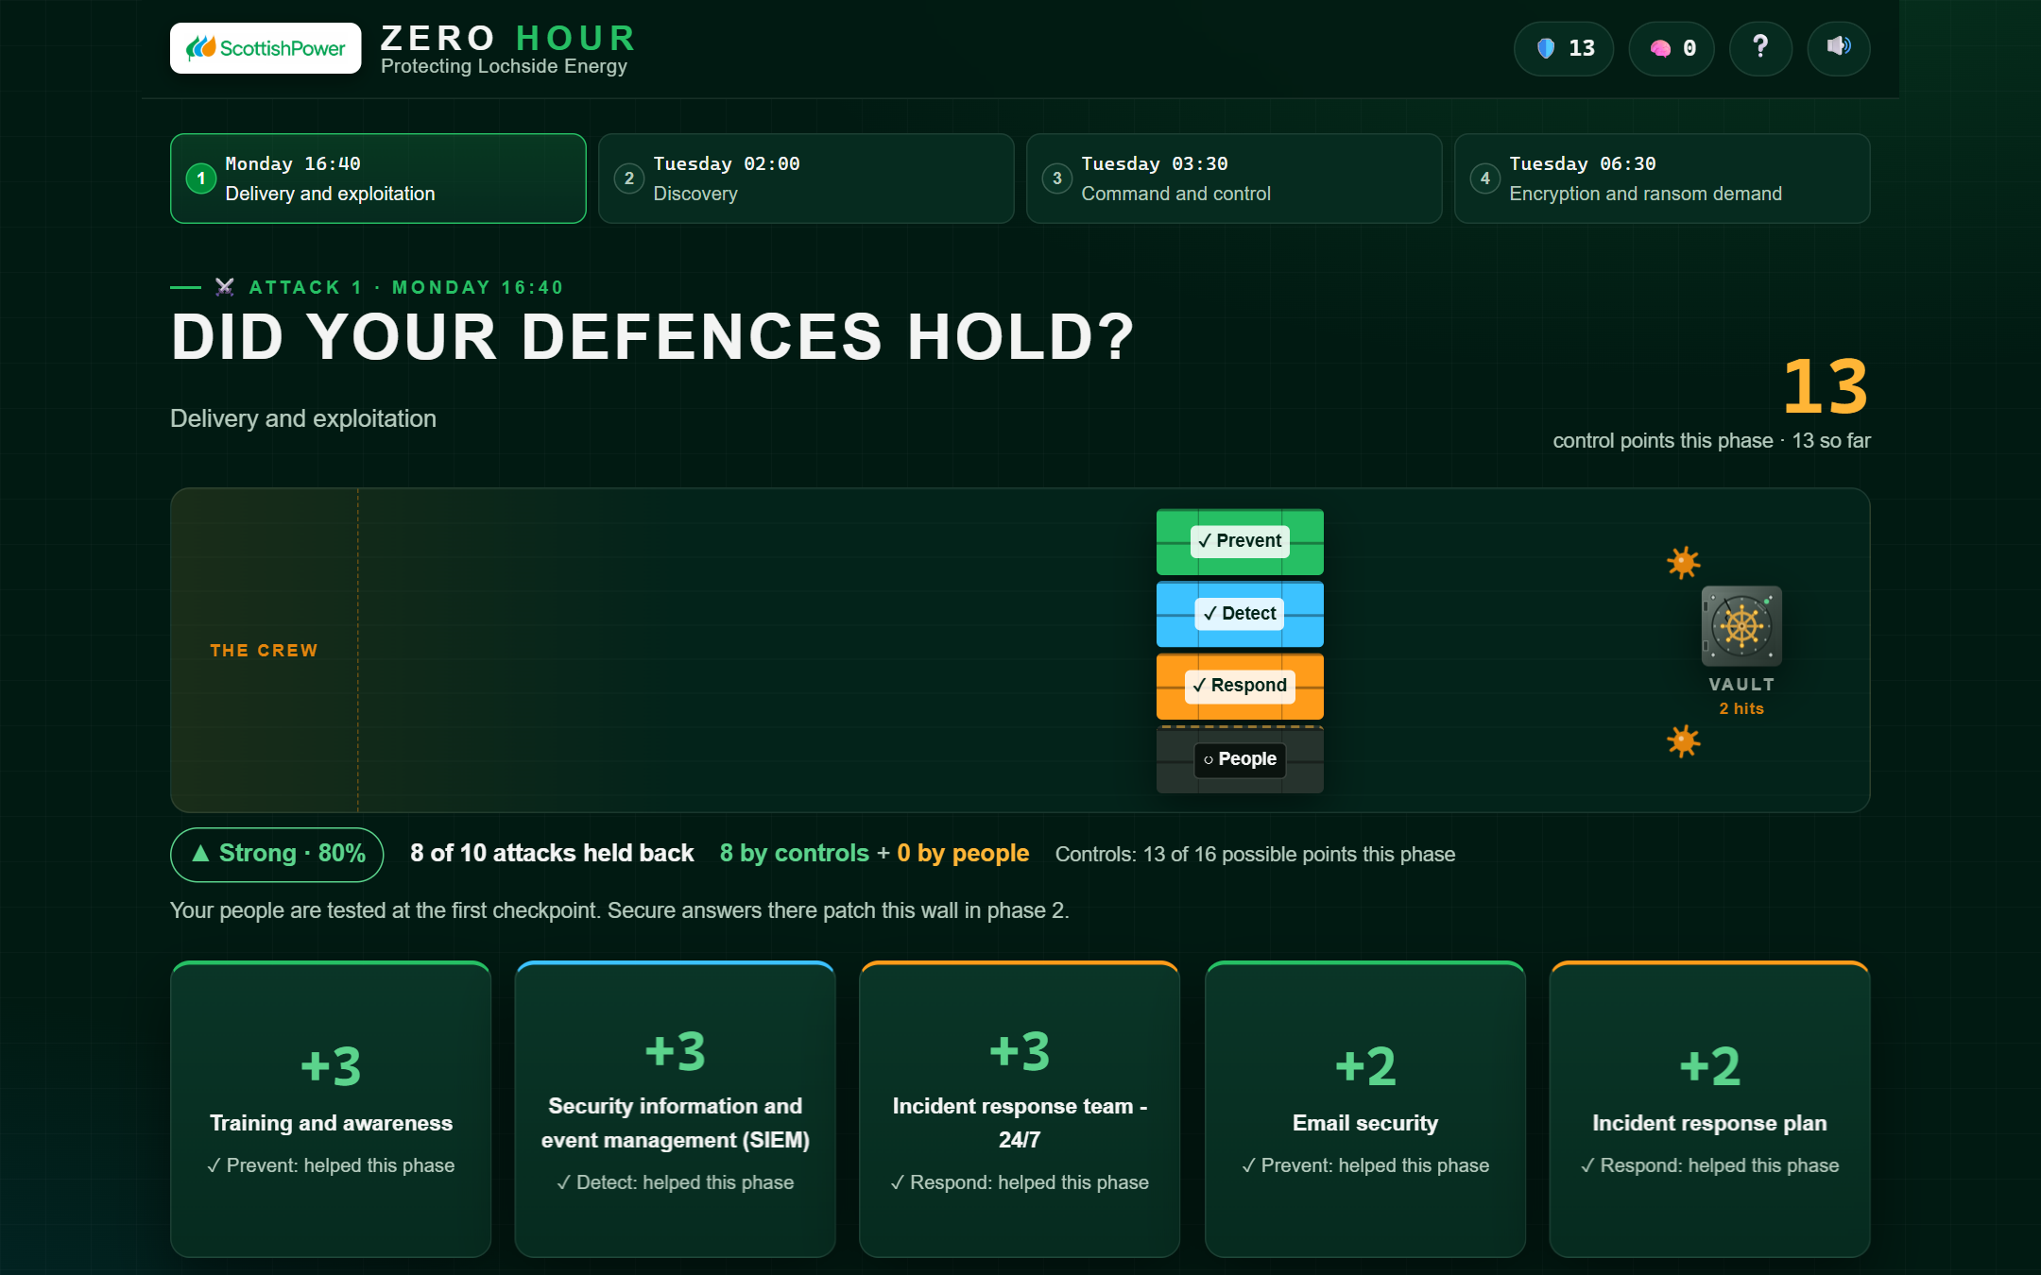
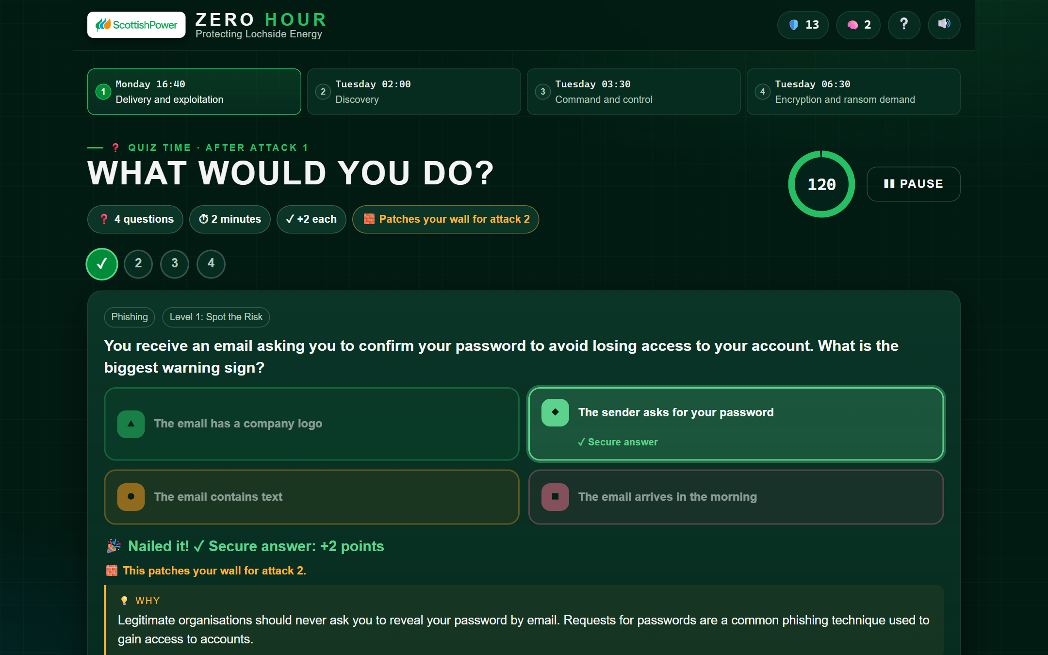
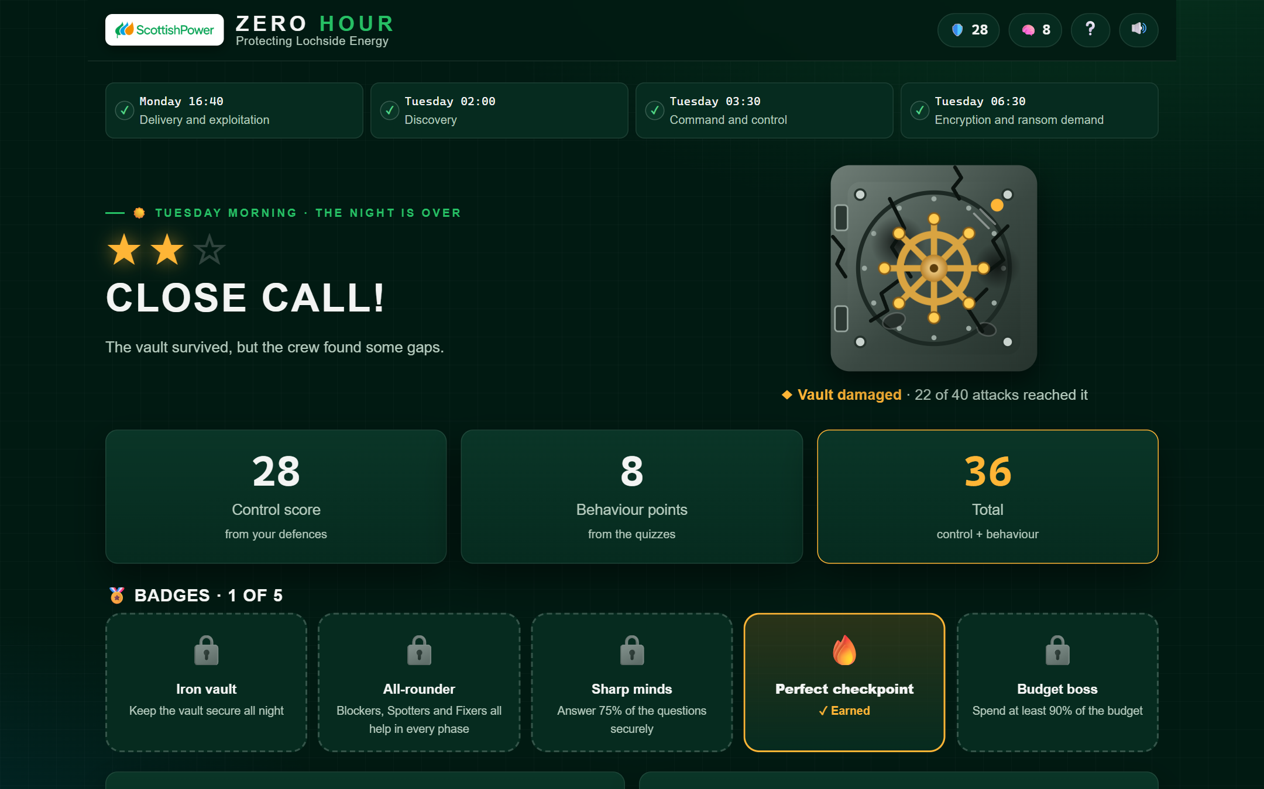
Four steps, one score
HOW IT PLAYS
1
2
3
4
Choose
Attack
Checkpoint
Debrief
Spend up to £3m on 18 controls. One Prevent, one Detect and one Respond in single player. Lock it in.
Four phases. Each one shows how many of 10 attacks your wall held, and what every control scored.
Four questions in two minutes. Secure answers earn points and patch the wall.
Control score + behaviour points = total. A night report says what worked and what to change.
Notes:
Four steps. Choose your controls within £3m and lock the plan. Then the attack: each phase hits your wall with 10 attacks and shows what each control scored. After every phase there is a two-minute behaviour checkpoint. At the end you get your control score plus behaviour points, and a night report that tells you what to change.

Slide 4
One night, four phases
THE ATTACK
Mon 16:40
Tue 02:00
Tue 03:30
Tue 06:30
Delivery
Discovery
Command and control
Encryption and ransom
A convincing email. Someone clicks.
The attacker explores while almost nobody is watching.
A call from "IT" asks the night desk for a sign-in code.
Files are locked just before the day shift.
9 vs 1
The timing is the lesson. Most of the attack happens out of hours, so a 24/7 response team scores 9 points across the night where an office-hours team scores 1. Players feel why round-the-clock cover matters.
Notes:
The attack runs from Monday 16:40 to Tuesday 06:30, exactly as in ScottishPower's scenario. The timing is the lesson: in the supplied scores, the 24/7 incident response team earns 9 points across the night, the office-hours team only 1, because the attack happens while the office is shut.

Slide 5
Your answers change the game
THE QUESTIONS
4
questions per phase, picked to match what just happened, easiest first
PHASE 3 · TUE 03:30 · MFA · PRESSURE TEST
A caller from "technical support" is fixing your account. An MFA request appears and they ask you to approve it.
+2
points for a secure answer. Wrong or missed: 0, and the explanation still shows
✓ Refuse, verify independently, and only approve requests you started yourself.
2:00
per checkpoint. The facilitator can pause the clock
It lands straight after the story's fake IT call, so the lesson sticks.
30%
Secure answers patch the wall: your people stop up to 30% of what got past your controls in the next phase
Behaviour points are kept separate from the control score, which always comes from ScottishPower's own scoring module.
Notes:
After every phase, four questions from the bank of 40, chosen to match the story: in phase 3, right after the fake IT call, you get the MFA approval question. A secure answer is worth 2 points. And the answers change the game, not just the score: secure answers patch your wall, so your people stop up to 30 percent of the attacks that got past your controls in the next phase. The control score itself always comes from ScottishPower's supplied scoring module, unchanged.

Slide 6
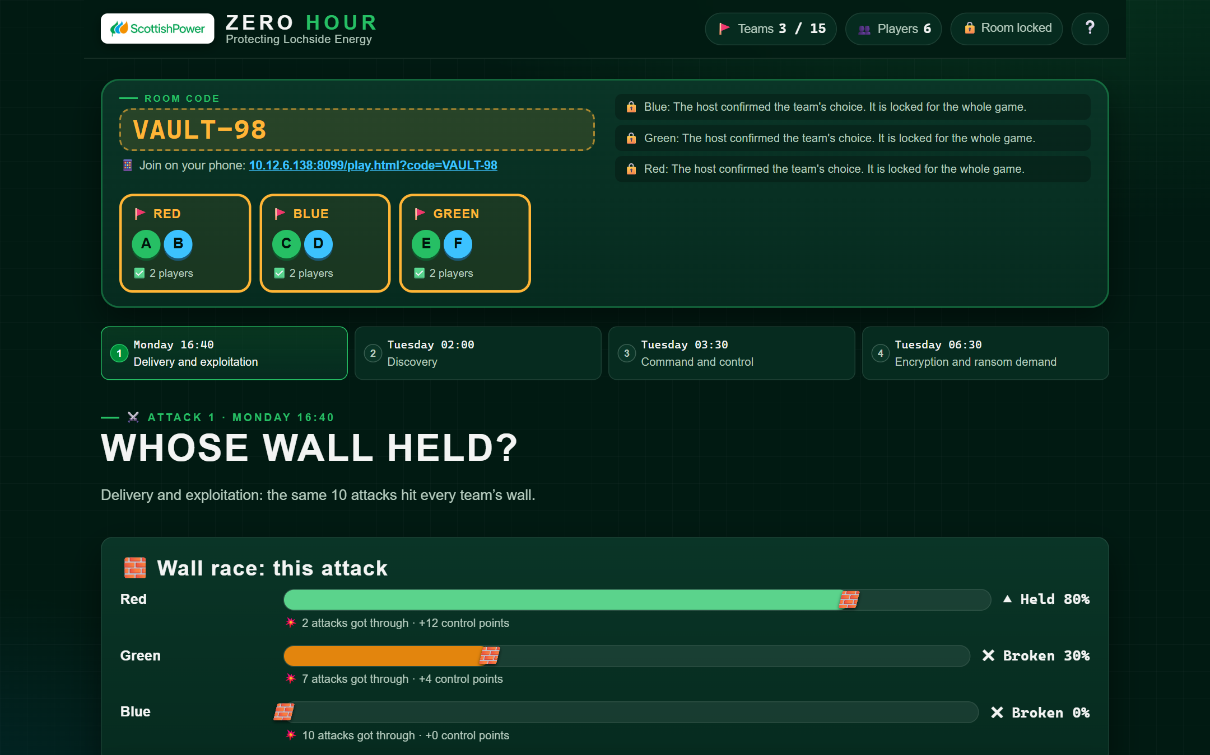
Team battle: whose wall holds?
STRETCH · MULTIPLAYER
1
Up to 15 teams
join one room from their phones with a code and a team name
2
2+ players a team
each team gets its own £3m and splits Prevent, Detect and Respond
3
Same attacks
the host runs one night: every wall faces the same 40 attacks
4
Fair and safe
the room locks when the night starts; players who leave or drop are never ghosts
Notes:
Our stretch is multiplayer, taken further into a team battle. Up to 15 teams join one room from their phones. Each team needs at least two players, gets its own £3 million, and splits the Prevent, Detect and Respond roles. The host runs one night for everyone, so every wall faces the same attacks, and the screen shows whose wall held after each phase. The room locks when the night starts, and a player who leaves disappears instead of staying as a ghost.

Slide 7
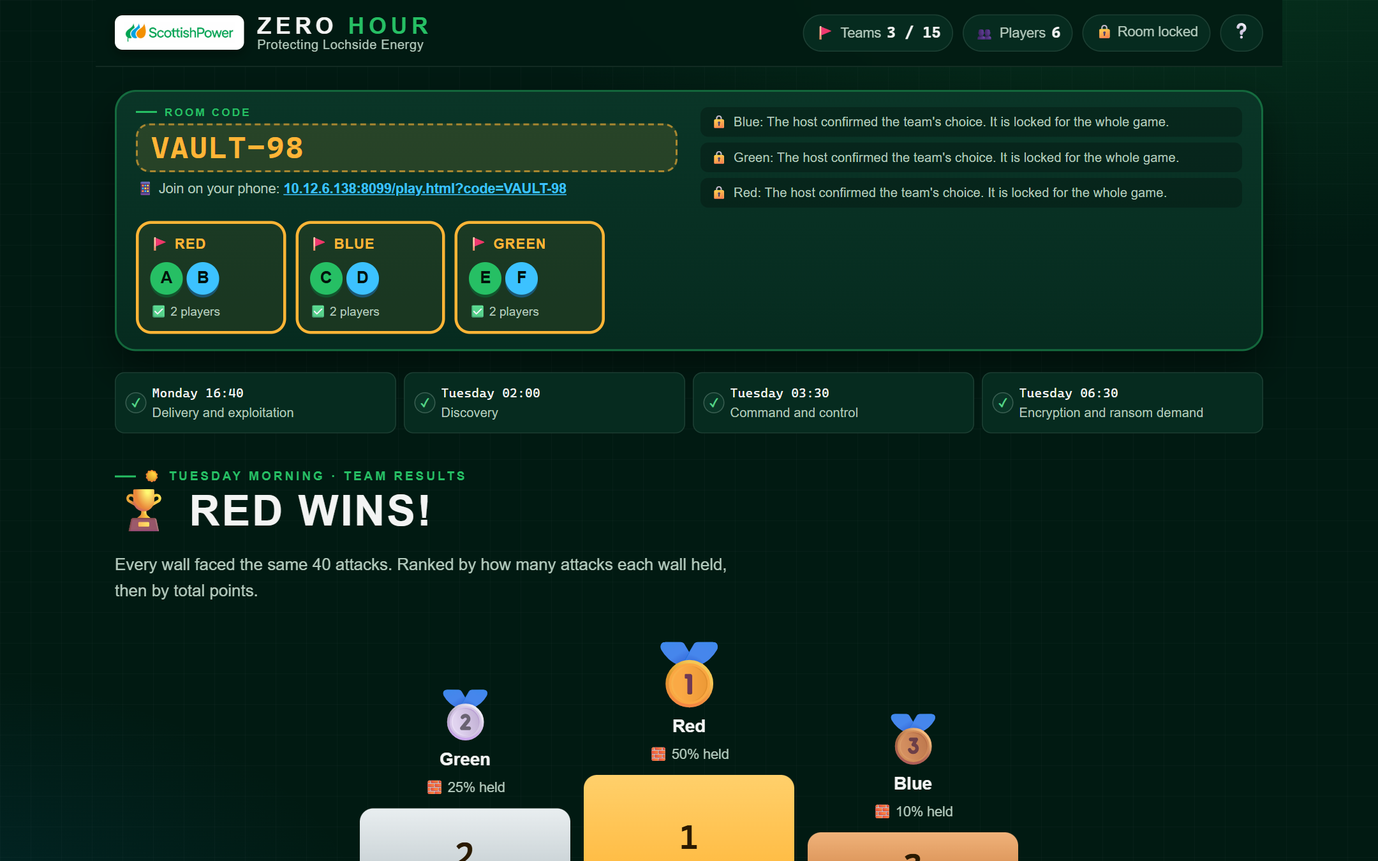
Let's play it
LIVE DEMO
Host opens a room on the big screen
Two teams join from phones: Red and Blue
Each team buys its defences; one refused buy shows the rules
Lock the plans: the room locks too
Reveal phase 1: whose wall held?
One checkpoint answer patches the wall
Jump to the podium and the night report
Try it yourself: team-20-vglm.onrender.com
Notes:
Demo, about 3 minutes. Open the live site 5 minutes before, because the free hosting sleeps. 1) Host: Multiplayer, Host, Open a room. 2) Two phones join as Red and Blue. 3) Buy a few controls; show one refused buy, for example a Detect player trying a Prevent control. 4) Lock the plans and show the Room locked chip. 5) Reveal phase 1: the wall race. 6) Answer one checkpoint question on a phone and point at the People row on the wall. 7) Skip to the podium and open the night report. Backup if the Wi-Fi fails: npm start on the laptop, and use browser tabs as phones.

Slide 8
One state per team, one place that changes it
HOW IT IS BUILT
DATA · SUPPLIED
ENGINE · state.mjs
CALLS
challenge.json
reduce(game, state, action)
scoreSelection
questions.json · the cyber team's content
Returns a new state. The only code that changes the game.
supplied, unchanged · checkpoint functions
actions
new state
SERVER · competition → rooms
SCREENS · src/ui
REPORTS · pure functions
Teams, roles, room lock
Read state, send actions
Debrief, night report, standings
Who may act. One state per team; time and player come from the server, never a phone.
Same screens on one laptop or on phones, updated live (server-sent events).
Worked out from the final state, so they always agree with the scores.
Single player runs the same reduce() in the browser; team battle runs it on the server, one copy per team.
Notes:
Everything goes through one pure function, reduce(game, state, action), which returns a new state. Single player runs it in the browser. In the team battle the server runs it, one state per team: competition.mjs handles teams and the room lock, rooms.mjs checks who may act, and the engine decides what is allowed. Screens only read state and send actions. Scores always come from the supplied scoring module, unchanged.

Slide 9
The server owns the state; phones only ask
A DESIGN DECISION
We considered
We chose
Because
Each phone keeping its own copy of the game and sending results, with timers that read each device's own clock.
One reducer per team on the server. A phone sends "buy P3"; the server adds who and when, applies it, and pushes the new state to every screen.
Two phones spending the last £100k at once can't both win. Every screen shows one clock. A test can jump "two minutes later" in one line.
Notes:
Our main design decision: the server owns the state and phones only ask. We considered letting each phone keep its own copy, but then two phones could spend the same money twice and every screen would have its own clock. Instead, each team has one reducer on the server; the server stamps who did what and when, and pushes the new state to everyone. Because time is passed in, a test can jump two minutes ahead in one line.

Slide 10
Every rule in the brief has a test
TESTS
338
THE TEST WE ARE GLAD WE WROTE
Two phones spend the last of the budget at the same moment
tests passing, 0 failing
£100,000 left. Two players each try to buy a £100,000 control at once, over the real server. Only the first goes through; the second gets a clear "not enough budget" message, and the plan stays valid.
npm test
Scores checked against the supplied scoring module
Real server tests: live updates, refresh, room lock
An audit suite found 6 bugs; all fixed, tests kept
It is the bug most likely to happen in a shared game, and the easiest to miss.
Notes:
338 tests, all passing; anyone can run npm test. Scores are always checked against the supplied scoring module. There are real server tests for live updates, refreshing a phone and the room lock. Ghassan wrote an audit suite that found six real bugs, such as the server serving hidden files; we fixed all six and kept the tests. The test we are glad we wrote: two phones spending the last £100,000 at the same moment, where only the first should go through.

Slide 11
What works, what doesn't, and where AI helped
BEING HONEST
Works
Not yet
AI helped with
Single player and team battle, end to end
Phones on any network via the live site
Room locks at start; no ghost players
Refresh a phone and you are back in your seat
Keyboard play and reduced-motion support
Games live in server memory: a restart ends them
Free hosting sleeps: first load can take a minute
Rooms are not cleaned up yet (about 90 per restart)
No accounts: a name and team re-claims a seat
Not tested with a screen reader
Reading the brief and planning
Drafting code, tests and documents
Reviewing code for bugs
We designed it, ran every test ourselves and checked scores against the supplied module
Notes:
Being honest. Works: both modes end to end, phones on any network through the live site, the room lock, no ghost players, and reconnecting after a refresh. Not yet: games live in memory, so a restart ends them; the free hosting sleeps; rooms are not cleaned up yet; there are no accounts, so a name and team can re-claim a seat; and we have not tested with a screen reader. AI helped us plan, draft code and tests, and review; we made the design choices and checked everything with the tests and the supplied scoring module.

Slide 12
OVER TO YOU
Questions?
Next for ScottishPower: the scenario and questions are plain JSON files, so the cyber team can change prices, scores and questions without touching the code, and one web link reaches every team.
Play it: team-20-vglm.onrender.com
Tejas
Rayyan
Ghassan
Vansh
Mo
Engine
Rules & screens
Checkpoints & audit
Team battle & deploy
Tests & debrief
Notes:
Thank you. For ScottishPower, the route forward is simple: the scenario and questions are plain JSON files the cyber team can edit, and one web link reaches every team. Happy to take questions; any of us can explain a part of the code or a test.

Slide 13

THANK YOU
Notes:
Thank-you video. It plays by itself when this slide opens (about 14 seconds).

